Slide 1
Brixham C of E
Subtitle
Vision and Values

Slide 2
‘Life in all its fullness’ (John 10:10)
Our Vision
Jesus said 'I have come that you may have life in all its fullness' (John 10:10). He calls us to a full life in mind, body, heart and spirit. Therefore we believe the purpose of education is to nurture and enable every child to thrive and to be the person they are fully capable of being.

Slide 3
Throughout our curriculum, we use the lens of ‘gateways’ to develop our character. These also support our school values.

Slide 4
Our Values are underpinned by biblical theology

Slide 5
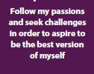
Jesus Cleanses the Temple
The Lost Sheep
Jesus Heals the Blind
Solomon's Wisdom
Luke 1:37
For nothing will be impossible with God.

Slide 6
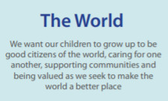
The Prodigal Son
Zacchaeus the tax collector
Zelophehad’s Daughter
Jacob and Esau
Zechariah 8:16
Tell the truth to each other

Slide 7
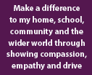
The Good Samaritan
Miriam’s little brother Moses
Tabitha Supports the Poor
The washing of the disciple’s feet
Matthew 25:39
Love your neighbour as yourself

Slide 8
Esther the Brave
Jesus Feeding the 5000
David and Goliath
Moses Leads his People
Joshua 1:9
Be strong and courageous; do not be frightened or dismayed, for the lord your God is with you wherever you go

Slide 9
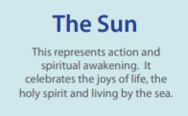
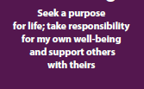
The Wise and the Foolish Builder
Parable of the Talents
Through the Roof
The Widows Mite
Philippians 4:13
I can do all things through him who strengthens me’

